Slide 1
Unit-1 OVERVIEW OF C++ PROGRAMMING

Slide 2
Contents
Introduction to C++ Programming Language:
Brief history of C++, Key features of C++: efficiency, performance, and versatility, Role of C++ in modern software development
Fundamental Types and Portability:
Understanding fundamental data types in C++, Challenges related to data type portability
Introduction to Object-Oriented Programming (OOP):
Core principles of OOP: Abstraction, Encapsulation, Inheritance, Polymorphism, Differences between Object-Oriented and Procedural programming, The significance of OOP in software development.
Standard Library and Namespaces:
Introduction to the C++ Standard Library, Overview of namespaces in C++, Importance of using namespaces, structure of C++ program, data member, member function, initializing object with constructor

Slide 3
Introduction to C++
C++ is a general-purpose programming language that was developed as an enhancement of the C language to include object-oriented paradigm.
It is an imperative and a compiled language.
C++ is a high-level, general-purpose programming language designed for system and application programming.
It was developed by Bjarne Stroustrup at Bell Labs in 1985 as an extension of the C programming language.
One of the key features of C++ is its ability to support low-level, system-level programming, making it suitable for developing operating systems, device drivers, and other system software.
At the same time, C++ also provides a rich set of libraries and features for high-level application programming, making it a popular choice for developing desktop applications, video games, and other complex applications.

Slide 4
Key Features of C++
Object-Oriented Programming (OOP): C++ supports OOP principles, making it easier to design, organise, and manage code. It allows developers to create classes, objects, and inherit properties and behaviours.
Classes and Objects: C++ enables the creation of classes and objects, facilitating the modelling of real-world entities. This enhances code organisation and reusability.
Templates: C++ templates allow developers to write generic code that can work with any data type, making it easier to write reusable and flexible code.
Standard Template Library (STL): The STL provides a wide range of containers and algorithms for working with data, making it easier to write efficient and effective code. It is a collection of template classes and functions that provide essential data structures (like vectors and lists) and algorithms (like sorting and searching). It simplifies complex programming tasks.
Exception Handling: C++ provides robust exception handling capabilities, making it easier to write code that can handle errors and unexpected situations.
Performance: C++ offers high performance and low-level memory control, making it a preferred choice for system-level programming and resource-intensive applications.

Slide 5
Role of C++ in modern software development
Gaming
GUI based applications
Adobe Photoshop and Illustrator
Operating system
Database softwares
Browsers
Animation tools
Compilers
Banking applications
Embedded systems

Slide 6
Procedure Oriented Programming
C Programming was Procedure Oriented Programming, well known as structured programming language, was popular in 1980s.
It helped programmers to write moderately complex programs.
However, when the program grows larger, the structured approach got failed in achieving desired results, in terms of bug-free, easy to maintain and reusable programs.

Slide 7
Why Object Oriented Programming?
It is an approach to organize and develop program in such a manner, which would eliminate pitfalls of conventional programming methods, by incorporating the best structured programming with several powerful new concepts.
So, we can consider it as a new way of organizing and developing programs and it has nothing to do with language.
All languages do not support object oriented programming concepts easily.

Slide 8
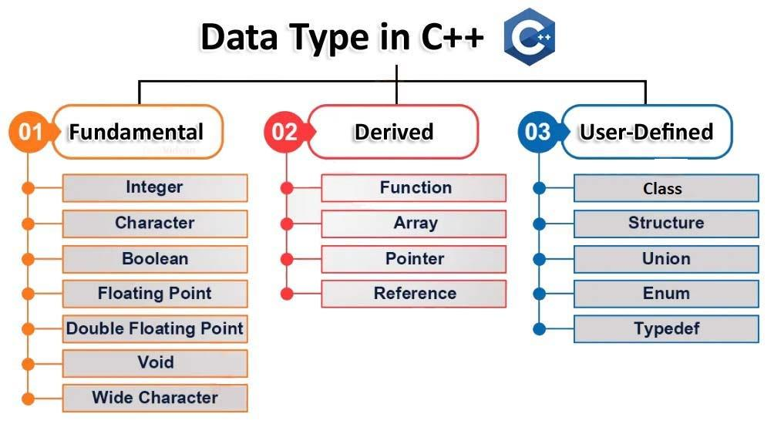
C++ Datatypes

Slide 9
C++ fundamental Datatypes
Whenever a variable is defined in C++, the compiler allocates some memory for that variable based on the data type with which it is declared as every data type requires a different amount of memory.
Data Type | Meaning | Size (in Bytes)
int | Integer | 2 or 4
float | Floating-point | 4
double | Double Floating-point | 8
char | Character | 1
wchar_t | Wide Character | 2
bool | Boolean | 1
void | Empty | 0

Slide 10
C++ fundamental Datatypes
Int
The int keyword is used to indicate integers.
Its size is usually 4 bytes. Meaning, it can store values from -2147483648 to 2147483647.
Eg. int salary= 20000;
Float and double
float and double are used to store floating-point numbers (decimals and exponentials).
The size of float is 4 bytes and the size of double is 8 bytes. Hence, double has two times the precision of float
E.g. float km = 250.20;
Double distance = 45E12 i.e. 45*10^12

Slide 11
C++ fundamental Datatypes
Char
Keyword char is used for characters.
Its size is 1 byte.
Characters in C++ are enclosed inside single quotes ' '.
E.g. : char Alpha = ‘A’;
Wchar_t
Wide character wchar_t is similar to the char data type, except its size is 2 bytes instead of 1.
It is used to represent characters that require more memory to represent them than a single char.
E.g.: w_char Alpha = L’ 日’; //Used for Japanese languages.
Notice the letter L before the quotation marks.

Slide 12
C++ fundamental Datatypes
bool
The bool data type has one of two possible values: true or false.
Booleans are used in conditional statements and loops.
E.g.: bool cond = false;
void
The void keyword indicates an absence of data. It means "nothing" or "no value".
We will use void when we learn about functions and pointers.
Note: We cannot declare variables of the void type.

Slide 13
Challenges in datatype portabilities
Data type portability in C++ refers to the ability of code using specific data types to behave consistently across different platforms, compilers, and architectures. Challenges arise because the exact size, representation, and alignment of data types can vary.
Following are the challenges:
1. Platform-Dependent Sizes:
Problem:
Fundamental data types like int, long, float, etc., do not have fixed sizes.
For example: On a 32-bit system, int is often 2 bytes.
On a 64-bit system, long may differ between platforms (e.g., 8 bytes on Linux but 4 bytes on Windows).
2. Standard Library Differences
Problem: Some library implementations or extensions may not be available or behave differently across platforms.

Slide 14
Cont..
3. Character Encoding
Problem: Different platforms may use different character encodings (e.g., ASCII vs. UTF-16).
4. Compiler-Specific Behavior
Problem: Compiler extensions or undefined behavior might work differently (or fail) when the code is compiled with a different toolchain.
5. Differences in sizeof
Problem: The sizeof operator's results depend on the data type size, which is not consistent across platforms.
6. Third-Party Libraries
Problem: Dependencies on third-party libraries can introduce portability issues if the libraries are not available or optimized for all platforms.

Slide 15
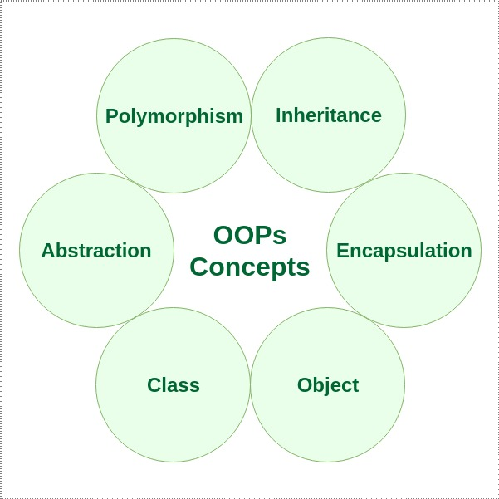
Introduction to Object-Oriented Programming (OOP):
As the name suggests uses objects in programming.
Object-oriented programming aims to implement real-world entities like inheritance, hiding, polymorphism, etc. in programming.
The main aim of OOP is to bind together the data and the functions that operate on them so that no other part of the code can access this data except that function.

Slide 16
What is a class?
It is a user-defined data type, which holds its own data members and member functions, which can be accessed and used by creating an instance of that class.
A class is like a blueprint for an object.
Data members => data variables and
member functions => functions
Functions are used to manipulate these variables and together these data members and member functions define the properties and behavior of the objects in a Class.
Example: Class of Cars .
There may be many cars with different names and brand but all of them will share some common properties like all of them will have 4 wheels, Speed Limit, Mileage range etc will act as data members.
Applying brakes, increasing speed may lead to member function of that class.

Slide 17
Class
A class can be thought of as a template used to create a set of objects.
A class is a static definition; a piece of code written in a programming language.
One or more objects described by the class are instantiated at runtime.
The objects are called instances of the class.
Each instance will have its own distinct set of attributes.
Every instance of the same class will have the same set of attributes;
every object has the same attributes but,
each instance will have its own distinct values for those attributes.

Slide 18
Data Members and Member Functions
Data members
The variables which are declared in any class by using any fundamental data types (like int, char, float etc) or derived data type (like class, structure, pointer etc.) are known as Data Members.
Member Functions
And the functions which are declared in class are known as Member functions.

Slide 19
What do you mean by an object?
Objects are the runtime entities, existing in the real world. They can be represented as person, a place, a bank account.
Real-world objects have attributes and behaviors.
Examples:
Dog =>
Attributes: breed, color, hungry, tired, etc.
Behaviors: eating, sleeping, etc.
Bank Account =>
Attributes: account number, owner, balance
Behaviors: withdraw, deposit
Note: When a class is defined, no memory is allocated but when it is instantiated (i.e. an object is created) memory is allocated.
One class can have multiple objects, which can interact with each other

Slide 20
POP VS OOP
 | Procedural Oriented Programming | Object Oriented Programming
Divided Into | In POP, program is divided into small parts called functions. | In OOP, program is divided into parts called objects.
Importance | In POP, Importance is not given to data but to functions as well as sequence of actions to be done. | In OOP, Importance is given to the data rather than procedures or functions because it works as a real world.
Approach | POP follows Top Down approach. | OOP follows Bottom Up approach.
Access Specifiers | POP does not have any access specifier. | OOP has access specifiers named public, private, protected, etc.
Data Moving | In POP, Data can move freely from function to function in the system. | In OOP, objects can move and communicate with each other through member functions.
Expansion | To add new data and function in POP is not so easy. | OOP provides an easy way to add new data and function.
Data Access | In POP, Most function uses Global data for sharing that can be accessed freely from function to function in the system. | In OOP, data cannot move easily from function to function. It can be kept public or private so we can control the access of data.
Data Hiding | POP does not have any proper way for hiding data so it is less secure. | OOP provides Data Hiding so provides more security.
Overloading | In POP, Overloading is not possible. | In OOP, overloading is possible in the form of Function Overloading and Operator Overloading.
Examples | Example of POP are: C, VB, FORTRAN, and Pascal. | Example of OOP are: C++, JAVA, VB.NET, C#.NET.

Slide 21
What is Encapsulation?
The wrapping up of data and functions into a single unit is known as encapsulation.
When classes are defined, programmers can specify that certain methods or state variables remain hidden inside the class.
These variables and methods are accessible from within the class, but not accessible outside it.
The insulation of the data from direct access by the program is called data hiding or information hiding.
Visible Methods
Hidden State Variables and Methods
Visible Variables
Class Definition

Slide 22
What is abstraction?
Abstraction refers to the act of representing essential features without including the background details or explanations.
Classes use the concept of abstraction and are defined as a list of abstract attributes such as size, weight, and functions to operate on these attributes. They encapsulate all the essential properties of the objects that are to be created.
Consider a real-life example of a man driving a car. The man only knows that pressing the accelerators will increase the speed of the car or applying brakes will stop the car but he does not know about how on pressing accelerator the speed is actually increasing, he does not know about the inner mechanism of the car or the implementation of accelerator, brakes etc. in the car. This is what abstraction is.

Slide 23
What is inheritance?
Inheritance is the process by which objects of one class acquire the properties of objects of another class.
The capability of a class to derive properties and characteristics from another class is called Inheritance.
Inheritance is one of the most important features of Object-Oriented Programming.
Sub Class: The class that inherits properties from another class is called Sub class or Derived Class.
Super Class: The class whose properties are inherited by sub class is called Base Class or Super class.
Reusability: Inheritance supports the concept of “reusability”, i.e. when we want to create a new class and there is already a class that includes some of the code that we want, we can derive our new class from the existing class. By doing this, we are reusing the fields and methods of the existing class.

Slide 24
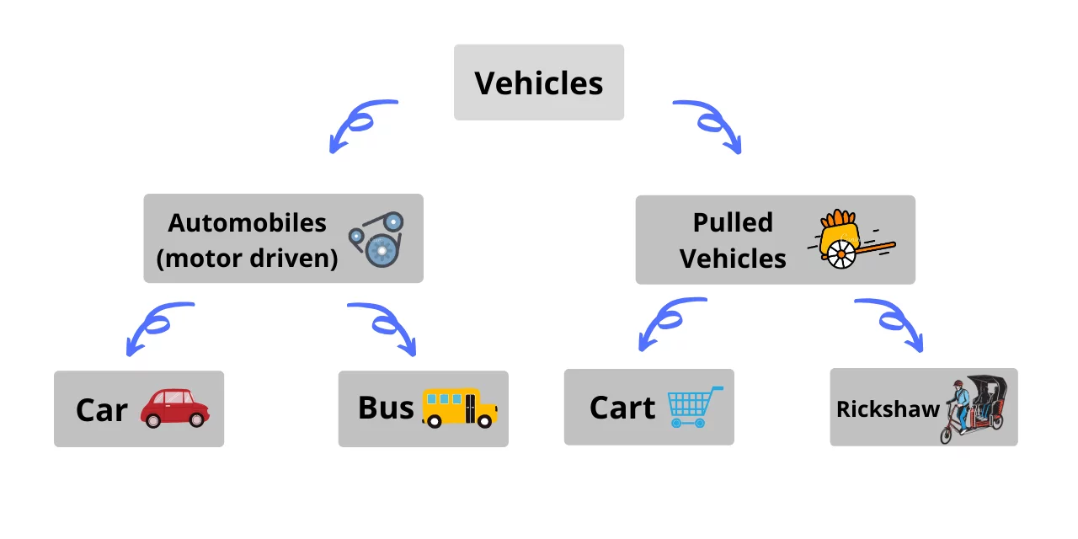
Inheritance Example

Slide 25
Polymorphism
Polymorphism is one of the essential features of an object- oriented language. It means ability to take more than one form.
An operation may exhibit different behaviours in different instances. The behavior depends upon the type of data used in the operations.
Example: Addition operation, with integer datatype, it will generate sum, but if operands are strings, it will generate third string by concatenation.
The process of making an operator to exhibit different behaviors in different instances is known as operator overloading.

Slide 26
Polymorphism cont..
Single function name can be used to handle different number and different types of arguments.
This is something similar to a particular word having several different meaning depending on the context. So, using a single function name to perform different types of tasks is known as function overloading.
Polymorphism is extensively used in implementing inheritance.
Shape
Draw ()
Circle Object
Draw (circle)
Triangle Object
Draw (triangle)
Square Object
Draw (square)

Slide 27
Dynamic Binding
Dynamic binding refers to linking a procedure call to code that will execute only once.
The code associated with the procedure is not known until the program is executed, which is also known as late binding.
Dynamic binding happens when all information needed for a function call cannot be determined at compile-time.
Dynamic binding can be achieved using the virtual functions.
Advantage of using dynamic binding is that it is flexible since a single function can handle different type of objects at runtime.

Slide 28
Significance of using OOP in software development
Increases productivity: OOP allows programmers to construct new programs quickly by using reusable code and multiple libraries.
Improves maintainability: OOP's modularity and reusability reduce redundancy and make code easier to maintain.
Simplifies troubleshooting: OOP's self-contained nature makes it easier to identify the source of a problem in the code.
Models complex systems: OOP allows developers to create intuitive models of complex systems by representing real-world entities as objects with properties and behaviors.
Saves time: OOP's polymorphism allows a single function to adapt to the class it's in, saving time and making it easy to add new vehicle types.
Enhances flexibility: OOP's inheritance and polymorphism provide flexibility for your codebase.
Reduces development costs: OOP's maintenance and reusability benefits reduce development costs.

Slide 29
Standard Library and Namespaces:
In C++, a namespace is a collection of related names or identifiers (functions, class, variables) which helps to separate these identifiers from similar identifiers in other namespaces or the global namespace.
The identifiers of the C++ standard library are defined in a namespace called std.
In order to use any identifier belonging to the standard library, we need to specify that it belongs to the std namespace. One way to do this is by using the scope resolution operator ::
For e.g. std::cout << "Hello World!";
Here, we have used the code std:: before cout. This tells the C++ compiler that the cout object we are using belongs to the std namespace.

Slide 30
C++ std Identifiers
All the standard library identifiers provided by the standard header files like <iostream>, <string>, <vector>, etc. are declared in the std namespace.
For example, identifiers cin and cout are defined inside the standard header file <iostream> of the namespace std.
The first way we access identifiers in the std namespace is by directly qualifying the identifier with the prefix std::. Here,
std is the C++ standard library namespace
:: is the scope resolution operator

Slide 31
Introduction to the C++ Standard Library
The C++ Standard Library is a collection of functions, containers, and other tools that can be used in C++ programs:
Containers: Generic containers for storing data
Functions: Functions for manipulating containers, performing common tasks, and more
Streams: Generic streams for input and output, including interactive streams
Support: Support for some language features
The C++ Standard Template Library (STL) is a set of template classes and functions that provides the implementation of common data structures and algorithms such as lists, stacks, arrays, sorting, searching, etc.

Slide 32
Components of STL
The components of STL are the features provided by Standard Template Library (STL) in C++ that can be classified into 4 types:
Containers
Algorithms
Iterators
Functors

Slide 33
Overview of namespaces in C++,
Namespace provide the space where we can define or declare identifier i.e. variable, method, classes.
Using namespace, you can define the space or context in which identifiers are defined i.e. variable, method, classes. In essence, a namespace defines a scope.
Importance of using namespaces :
Example, you might be writing some code that has a function called xyz() and there is another library available which is also having same function xyz(). Now the compiler has no way of knowing which version of xyz() function you are referring to within your code.
A namespace is designed to overcome this difficulty and is used as additional information to differentiate similar functions, classes, variables etc. with the same name available in different libraries.
The best example of namespace scope is the C++ standard library (std) where all the classes, methods and templates are declared. Hence while writing a C++ program we usually include the directive using namespace std;

Slide 34
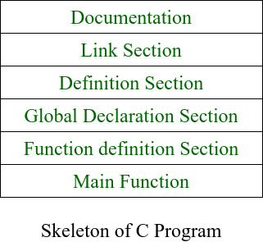
structure of C++ program
The structure of the program written in C++ language is as follows:
Documentation Section:
This section comes first and is used to document the logic of the program that the programmer going to code.
It can be also used to write for purpose of the program.
Linking Section:
The linking section contains two parts:
Header Files:
Standard headers are specified in a program through the preprocessor directive #include.

Slide 35
Cont..
Namespaces:
A namespace permits grouping of various entities like classes, objects, functions, and various C++ tokens, etc. under a single name.
Namespaces can be accessed in multiple ways:
using namespace std;
using std :: cout;
Definition Section:
It is used to declare some constants and assign them some value.
Global Declaration Section:
Here, the variables and the class definitions which are going to be used in the program are declared to make them global.
Function Declaration Section:
It contains all the functions which our main functions need.
Usually, this section contains the User-defined functions.
Main Function:
The main function tells the compiler where to start the execution of the program. The execution of the program starts with the main function.

Slide 36
Example of C++ program
#include <iostream>
int main() {
std::cout << "Hello World!";
return 0;
}
Output
Hello World!

